Slide 1
WTC HCIS
Billing

Slide 2








BI Developer and Analyst
Activity Modeller
Business Rule Editors
BRE
SAP Consultant
BAM Server
BI System
Internet
Firewall
Third party interfaces
WTC-HCIS
Nurses, Doctors, Administration staff, Chefs, Pharmacy
Patients, Doctors, Administrative staff, etc

Slide 3
Security Management
UI Layer
Web service Layer
Audit/Logging
Transaction Management
API Layer
Core
(Business Layer)
Report Layer
Data Access Layer
HCIS Database

Slide 4
Type of Billing
Inpatient Billing
Outpatient Billing

Slide 5
Scenarios for IP Billing
While Room booking.
While admitted
Interim payments to avail services.
Transfer of Bed.
While discharge.
Transfer to different hospital.

Slide 6
Charge Masters
Charge Master for
Beds
Operation Theatre
Services
Consultations
Physiotherapy
Appointments
Charges variable for
Same day Discharge.
Night charges.
Emergency Charges.
Age of Patient.

Slide 7
Room Booking
Patient Id
Registration
Admission
Services Availed
Transfers (Hospital / Bed)
Deposits
Discounts / Offers / Adjustments / Reimbursements
Pre-Discharge Request
Billing
Discharge

Slide 8
Room Booking
Patient Id.
Type of Bed (Bed Master).
Charge of the Beds (Charge Master).
Deposits.
Credit Limit.

Slide 9
Admission
Approval Doctors Name or ID.
Booking Deposit amount.
Amount paid while booking and mode of payment (voucher/cash/credit card).
Bed number and bed type admitted to.
Maximum Credit limit.
Low Credit notifications to (Doctor, Patient).

Slide 10
Service Availed
Services provided on daily basis like :-
Room Rent,
Operation,
Delivery,
Oxygen and other gases,
Consultations and Routine visits,
Nursing Charges,
Laboratory tests,
X-ray, Ultrasound,
Medicine,
Procedure.

Slide 11
Deposits
Type of Deposits
Booking Deposit
Security Deposit
Advance Deposit
Payment details
Voucher
Cash
Credit
Cheque
Advance Payment.
Deposit date and time.
Credit limits.
Deposit Type
Self
TPA

Slide 12
Discounts / Offers / Adjustments
Type of Adjustment
Credit
Debit
Type of Transaction
Type of offers
Packages
Long Term Relationship
Corporate Discounts
Management discounts.
Employee discounts.
Insurance.
Percentage.

Slide 13
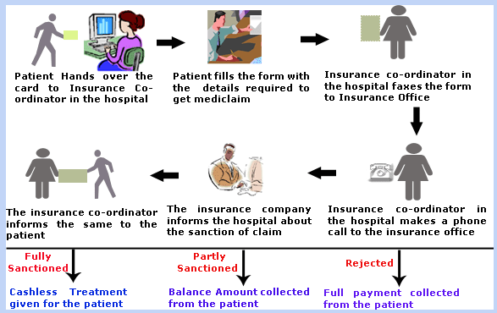
Insurance / Mediclaim

Slide 14
Billing / Payment Receipts
On patients request.
Exceeding Credit limit.
Stay more than 30 days.
Surgery
Transfers
Bed
Hospital

